Slide 1

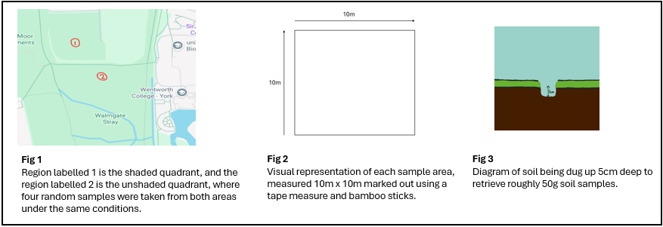
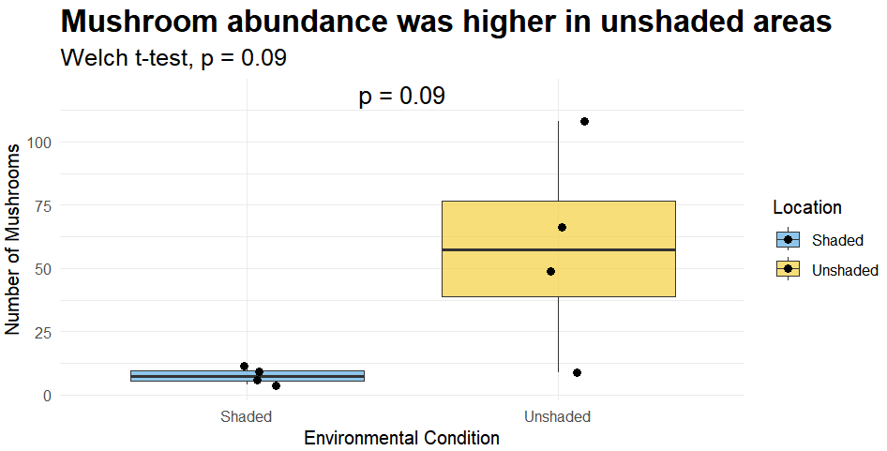
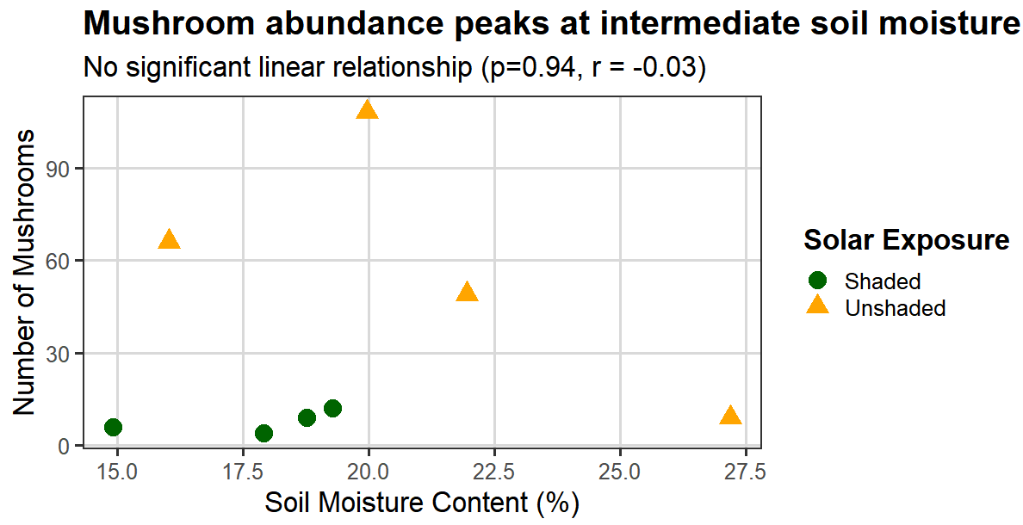
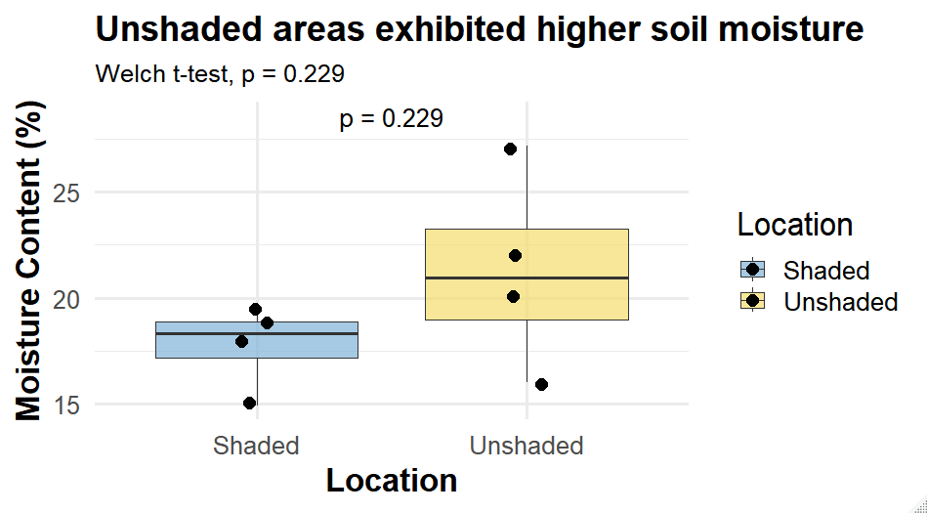
The Influence of Sunlight Exposure and Soil Moisture Levels on Fungi Fruiting
Introduction
Fungi are primary decomposers that are essential for nutrient cycling [1]
Fungal success is highly dependent on soil moisture levels, and sunlight exposure reduces soil moisture levels, potentially leading to desiccation which inhibits fruiting. [2]
The research objective is to determine if sunlight exposure significantly affects mushroom abundance with soil moisture levels being the explanatory variable
Hypothesis – Shaded areas will exhibit higher soil moisture and consequently a greater abundance of mushrooms compared to unshaded areas.
Methods
4 different sites in both unshaded and shaded areas were sampled (n=4)
Sites were randomly selected to avoid investigator bias in both environments
10m x 10m quadrats were used to measure mushroom abundance
Bamboo sticks used to mark 10m2 boundaries
Cameras were used to photograph each mushroom identified for documentation
Soil samples were collected to 5cm depth using a spade and placed in labelled bags
Soil moisture was measured using the oven-dry method. [3] Fresh soil was weighed, and dried until a constant mass then reweighed. Moisture content was calculating using the following formula :
Soil moisture (%) = (Fresh weight - Dry weight) / Fresh weight × 100
Figure 1
Boxplot showing mushroom abundance in shaded and unshaded 10m x 10m areas. (n=4) Mean abundance was higher in unshaded sites (58.0) than shaded sites (7.75), but the difference was not statistically significant (Welch’s t-test, p = 0.09)
Figure 3. Scatter plot showing mushroom abundance across a gradient of soil moisture (%) in shaded and unshaded quadrats.( n=4) Points are colour-coded by solar exposure. Pearson’s correlation indicated no significant linear relationship between soil moisture and mushroom abundance (r = −0.03, p = 0.94).
Location | Avg. Mushroom Count | Avg. Soil moisture (%)
Unshaded | 58.00 | 21.29
Shaded | 7.750 | 17.72
Key Takeaways
-Hypothesis is refuted Hypothesis Refuted – Unshaded areas have higher mushroom abundance than shaded areas despite greater solar exposure (avg. 58.0 compared to 7.77)
-Non-linear relationship between moisture levels and mushroom abundance indicates a potential “threshold effect” as mushroom abundance peaked at intermediate levels and not in a linear fashion.
Discussion
Refutation of hypothesis – Results directly contradict the initial hypothesis that shaded areas would exhibit greater mushroom abundance.
Biological significance – Although the Welch-t-test (p=0.09) did not reach the 0.05 threshold for significance, the notable biological difference in average mushroom abundance between unshaded (58.00) vs shaded (7.75) suggests that unshaded environmental conditions strongly favoured fruiting
Effect of moisture levels - Unshaded plots had a higher mean soil moisture content (21.29% vs 17.72%), suggesting that hydration levels are a primary driver of fruiting and outweigh any desiccation effects caused by solar exposure
“Threshold hypothesis” – No significant linear relationship was found between moisture and abundance (r= -0.03, p = 0.94), and mushroom abundance peaked at intermediate levels (20% moisture) suggests that fruiting peaks at moderate levels before declining, possibly due to the soil becoming waterlogged creating anaerobic conditions that inhibit fungal metabolism. Further research should investigate the threshold hypothesis to clarify the non-linear relationship.
Figure 2
Distribution of soil moisture content in shaded vs unshaded areas. (n=4) The unshaded area had a higher mean moisture content (21.29%) than the shaded area (17.72%), but the difference was not statistically significant (Welch’s t-test p= 0.229)
Limitations
Small sample size (n=4) limited statistical power, reducing the ability to detect significant differences despite large biological variation in mushroom totals between both sites (31 vs 232).
High variability within unshaded plots (9-108 mushrooms) further contributed to non-significant Welch t-test results.
The study did not control for additional environmental factors known to influence fungal fruiting including soil pH, temperature, nutrient availability and interspecific competition,
Data were collected at a single time point which fails to account for the fact that fungal fruiting responds rapidly to short-term environment changes [1], so results may only reflect recent weather conditions rather than long-term patterns
Mushroom species was not identified and accounted for.
[1] Sakamoto Y. Influences of environmental factors on fruiting body induction, development and maturation in mushroom-forming fungi. Fungal Biol Rev. 2018;32(4):236–48.
[2] Arias-Real R, Gutiérrez-Cánovas C, Muñoz I, Pascoal C, Menéndez M. Fungal Biodiversity Mediates the Effects of Drying on Freshwater Ecosystem Functioning. Ecosystems. 2021 Aug 3;25(4):780–94.
‌[3] Construction How. Determination of moisture content: oven drying method [Internet]. 2024 [cited 2024 May 15]. Available from: https://constructionhow.com/moisture-content-oven-drying/‌

